Slide 1

How might we tackle sedentary lifestyle and promote balanced active living among youths?
By: Cindy, Hendy, Ryan, Chun Yang & Ler Yan

Slide 2
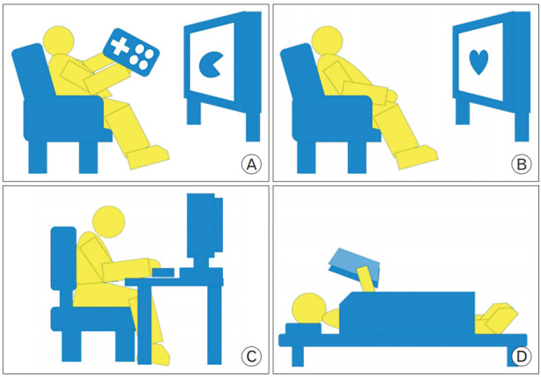
Problem Statement
Rising concern for the increasing number of youth engaging in sedentary lifestyle in Singapore.

Slide 3
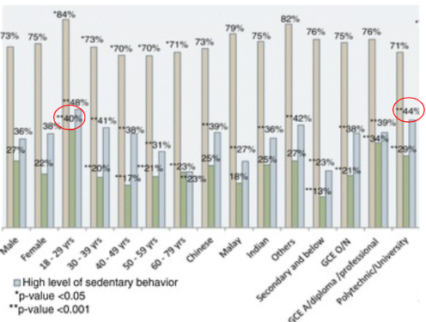
Evidence
Around 37% of Singaporeans sat at least 8 hours per day (high level of sedentary behavior).
Highest among youngest participants aged 18 to 29 years (40%).
High level of sedentary behavior was reported by 44% of participants with polytechnic, university and above level of education.
Notes:
Around 37% of Singaporeans sat at least 8 hours per day (high level of sedentary behavior). The prevalence was highest among youngest participants aged 18 to 29 years (40%).
The prevalence decreased with increasing age groups. Chinese participants had highest prevalence (38.5%) followed by Indians (36.2%) and Malays (26.8%). High level of sedentary behavior was reported by 44% of participants with polytechnic, university and above level of education. The prevalence increased with increasing educational level.

Slide 4
Client Segment
18 - 35 Years old youth in Singapore
Mainly students and young working adults (office environment, WFH, HBL)
Reasons:
They are the group that sits around for 8 hours or more per day due to studying and using electronic devices during office hours
When they have more work/ studies to do, they will spend their extra time on it, causing even less time to exercise

Slide 5
Causes and Risks of Sedentary Lifestyle
Causes
Lack of time due to work/ home commitments
Environment
Habits
Covid situations
Personality (Lazy, like to procrastinate)
Personal preference (Does not like to exercise/ sweat)
Unaware of the risks from sedentary lifestyle
Risks
Cardiovascular disease
Cancer risk (Colon Cancer)
Metabolic disorders: Diabetes mellitus, Hypertension, Lipid disorder
Musculoskeletal disorders: Arthralgia (stiff joints), Osteoporosis (weaken bones)
Depression
Cognitive impairment
Obesity
Notes:
https://www.todayonline.com/world/move-3-minutes-every-half-hour-counter-ill-effects-sitting?cid=telegram_tg-single_social-free_26012019_today

Slide 6
Proposed Project: 10 Week Zoom Healthy Habits
Time (hrs) | Activity
2000-2030 | Short introduction, explaining rules of the game throughout the programme, and sharing content about sedentary lifestyle
2030-2035 | Break (Emphasize 20 min stretch rule)
2035-2050 | Ice breaker Games
2050-2130 | Dance/ Workout Session
2130-2135 | Debrief
It will happen twice per week, Tuesday and Thursday. Participants can choose which day to join, only need to join once per week.
Notes:
10 weeks - inculcate a habit in the participants

Slide 7
Content Sharing of Sedentary Lifestyle
Week 1 and 2: Health and Nutrition
Week 3 and 4: Health and Fitness
Week 5 and 6: Health and Diseases
Week 7 and 8: Health and Maturation
Week 9 and 10: Health and Wholeness in Building Resilience
(Notes will be referenced from, and given credit to CC0005 Health Living and Well Being Lecture Notes)

Slide 8
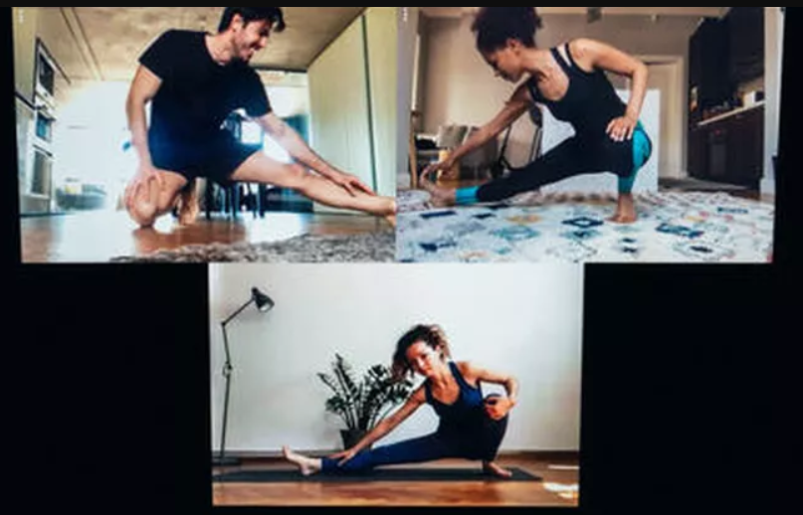
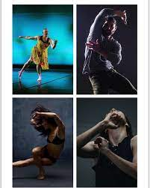
Key Activities
Ice breaker
Action Telepathy (3min)
The host will ask set of questions like eg. what action you will do when you wake up? And the participant will try to do the same posture and if more than half of the participant shows the same posture, everyone will get 10 points each
Dance master (2min)
Host will play popular songs among youth and every participant will vibe and dance to the tunes of the song for 2 minutes (they can do any movement that they like)
Person who moves the most/ can see very obvious sweat will be given 10 points. (Can be awarded to more than 1 person)

Slide 9
Key Activities
2 minutes push up | 2 minutes sit up | 1 minute elbow plank | 1 minute wall sit
1 minute 30 seconds mountain climbers | 20 burpees | 2 minutes jumping jack | 45 squats
1 minute russian twist | 1 minute forward lunge | 1 minute reverse lunge | 1 minute leg raise
3 minutes elevated push up | 3 minutes crunches | Elbow side planks (Both sides 1 minute each) | 1 minute raised arm circles (Forward and Backward)
Bingo Game (10min)
Participants are each given an image of Bingo template. Each box is a given action/ exercise that needs to be completed. For every line completed, participants will receive points
Only two people can do at the same time within 10 minutes, so the opportunity to cross out boxes is on a first come first serve voluntary basis
Each line crossed out is 10 points

Slide 10
Key Activities
Dance/ Workout Session (40 mins)
Week 1: Jaime Teo
Week 2: Instructor from O’School
Week 3: Sandra Riley Tang
Week 4: Joshua Tan
Week 5: Instructor from Converge
Week 6: Benjamin Kheng
Week 7: Instructor from Recognize! Studios
Week 8: Michelle Tan
Week 9: Instructor from EV Dance
Week 10: Hosts (us)
(Attendance: 10 points)
Notes:
References: https://shopee.sg/blog/singaporean-celebrity-fitness-influencers/
https://www.timeout.com/singapore/dance/the-best-dance-studios-and-classes-in-singapore

Slide 11

Points System
Points | Awards
50-60 | 3 Packets of Milo consisting of sachets
61-80 | 4 Packets of Milo consisting of sachets, 1 tin of Quaker Oats
81-100 | 4 Packets of Milo consisting of sachets, 2 tins of Quaker Oats
100-150 | 4 Packets of Milo consisting of sachets, 3 tins of Quaker Oats, 2 Litres of Magnolia Fresh Milk, 10$ Nestle Shopping Voucher
151-200 | 4 Packets of Milo consisting of sachets, 3 tins of Quaker Oats, 4 Litres of Magnolia Fresh Milk, 20$ Nestle Shopping Voucher
200 and above | 4 Packets of Milo consisting of sachets, 3 tins of Quaker Oats, 2 Litres of Magnolia Fresh Milk, 2 Boxes of Cereals, 50$ Nestle Shopping Voucher

Slide 12

Outreach
Social media (Instagram, Facebook, Telegram)
Posters (E-Posters/ Physical posters in lifts, at bus stops, outside schools - universities and polytechnics)
Celebrities (Get their help to advertise on their social media and their social circle)
Flyers (At school and CBD area)
Collaborate with schools/ companies to get their students/ employees to join

Slide 13
Feasibility Effectiveness
Cost
Zoom - no logs needed
Hiring of dance instructors/ celebrities - can collaborate with HPB for grants, collaborate with influencers/ celebrities’ agencies
Reward for points - various healthy food and drinks brand (Marigold, Nestle, Quaker) - can get sponsorships
Event of Reach
Schools and organisations
Covid-19
All measures adhered to as all activities are done online
Timeframe
Long term event to target kicking the habit of sedentary lifestyle and form new healthy habits
Appealing
Point systems motivates youths to participate weekly
Able to interact with celebrities
Replacing sedentary time with MVPA
Can reduce Cardiovascular Disease
10 mins of ST to MVPA - 38 % reduction
30 mins of ST to MVPA - 77% reduction
Notes:
Can reduce detrimental effects of sedentary activities
Programme used as stepping stone to achieve this target

Slide 14
Intended outcomes of our programme
Short-term
Able to encourage youths to participate in physical activity
Make youths feel the motivation to start exercising again, not just to keep fit but also to keep healthy
Raise awareness of the side effects of sedentary lifestyle
Long-term
Increase moderate-to-vigorous physical activity (MVPA) compare to sedentary activities
Reduce the risk factor cause by sedentary lifestyle
Cultivate youth’s interest towards exercising

Slide 15

Call to Action
Create a QR Code and a sign up link
Make a promise: Join now and lose weight with us!
Get active with Singapore celebrity
Ig and Facebook: a learn more or sign up button
Sign up now and stand a chance to win free Nestle Shopping Vouchers
Join now and enjoy some fun activities with your friends

Slide 16
Why should YOU join us?
Get to see and dance together with famous celebrities and dancers
10 Week long programme to inculcate a new healthy habit
Additional content for everyone, to raise awareness about the benefits of staying healthy and the risks of sedentary lifestyle instead of just a mundane workout session
Free vouchers and food based on participation rate
Serves as a dedicated time for participants to exercise and get sweaty, in the event that they get lazy or unable to plan a time out of their busy schedules

Slide 17
References
Park, J. H., Moon, J. H., Kim, H. J., Kong, M. H., & Oh, Y. H. (2020, November). Sedentary lifestyle: Overview of updated evidence of potential health risks. Korean journal of family medicine. Retrieved September 11, 2021, from https://www.ncbi.nlm.nih.gov/pmc/articles/PMC7700832/. (Slide 2)
Win, A. M., Yen, L. W., Tan, K. H. X., Lim, R. B. T., Chia, K. S., & Mueller-Riemenschneider, F. (2015, April 1). Patterns of physical activity and sedentary behavior in a representative sample of a Multi-ethnic South-East ASIAN population: A cross-sectional study. BMC public health. Retrieved September 10, 2021, from https://www.ncbi.nlm.nih.gov/pmc/articles/PMC4391474/. (Slide 3)
World Health Organization. (n.d.). Physical inactivity a leading cause of disease and disability, warns who. World Health Organization. Retrieved September 11, 2021, from https://www.who.int/news/item/04-04-2002-physical-inactivity-a-leading-cause-of-disease-and-disability-warns-who. (Slide 5)
Dohrn, I.-M., Kwak, L., Oja, P., Sjöström, M., & Hagströmer, M. (2018, January 25). Replacing sedentary time with physical activity: A 15-year follow-up O: Clep. Clinical Epidemiology. Retrieved September 12, 2021, from https://doi.org/10.2147/CLEP.S151613. (Slide 13)

Slide 18
Image Reference
Kennisgeving voor omleiding. (n.d.). Sedentary. Retrieved September 13, 2021, from https://images.hindustantimes.com/rf/image_size_630x354/HT/p2/2018/03/01/Pictures/couch-overweight-man-eating-working-drinking-out_9fb2711c-1d14-11e8-ba26-4f9ea6a8f74e.jpg (Slide1)
Sedentary Lifestyle: Overview of Updated Evidence of Potential Health Risks. (2020, November 1). PubMed Central (PMC). https://www.ncbi.nlm.nih.gov/pmc/articles/PMC7700832/ (Slide 2)
Patterns of physical activity and sedentary behavior in a representative sample of a multi-ethnic South-East Asian population: a cross-sectional study. (2015). PubMed Central (PMC). https://www.ncbi.nlm.nih.gov/pmc/articles/PMC4391474/ (Slide 3)
SocialMedia. (n.d.). Https://Www.Dreamstime.Com/Set-Most-Popular-Social-Media-Logos-White-Background-Facebook-Instagram-Twitter-Youtube-Telegram-Image186677161 (Slide 6)
Movement. (n.d.). Https://Www.Cnet.Com/Health/Fitness/Zoom-Workout-Classes-to-Try/. (Slide 9)
Dance Master. (n.d.). Dance Master. https://www.facebook.com/peabodybfadance/photos/day-1-of-our-zoom-master-class-series-excited-to-dance-with-jhonnielove-today-pe/848840022260300/ (Slide 9)
Reward. (n.d.). Https://Store.Magenest.Com/Media/Magento-Extension/Reward-Points-Magento-2/Reward-Point_reward-Customers.Png. https://store.magenest.com/media/magento-extension/Reward-Points-magento-2/reward-point_reward-customers.png (Slide 12)
(n.d.). how to create qr for a location. Retrieved September 13, 2021, from https://weblogue.net/how-to-create-a-qr-code-for-a-location/. (Slide 15)

